Slide 1
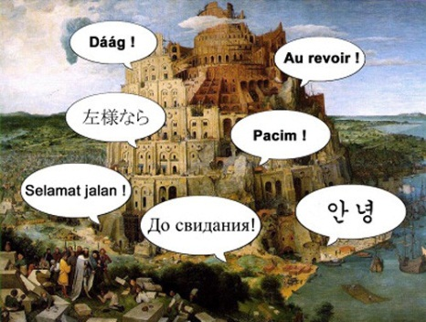
Findings from the IARPA Babel Program
Dr. Mary P. Harper
February 16, 2017

Slide 2
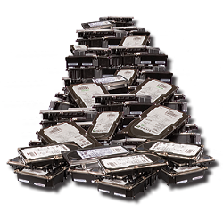
The Challenge
The IC acquires thousands of hours of noisy speech in languages of emerging importance.
Few IC analysts have the ability to understand these languages.
There is no existing speech technology for these languages.
Rapid development of effective speech search capabilities would go far to assist those few analysts.
Need capability to quickly train speech models to process possibly noisy speech in any language with limited resources
2

Slide 3
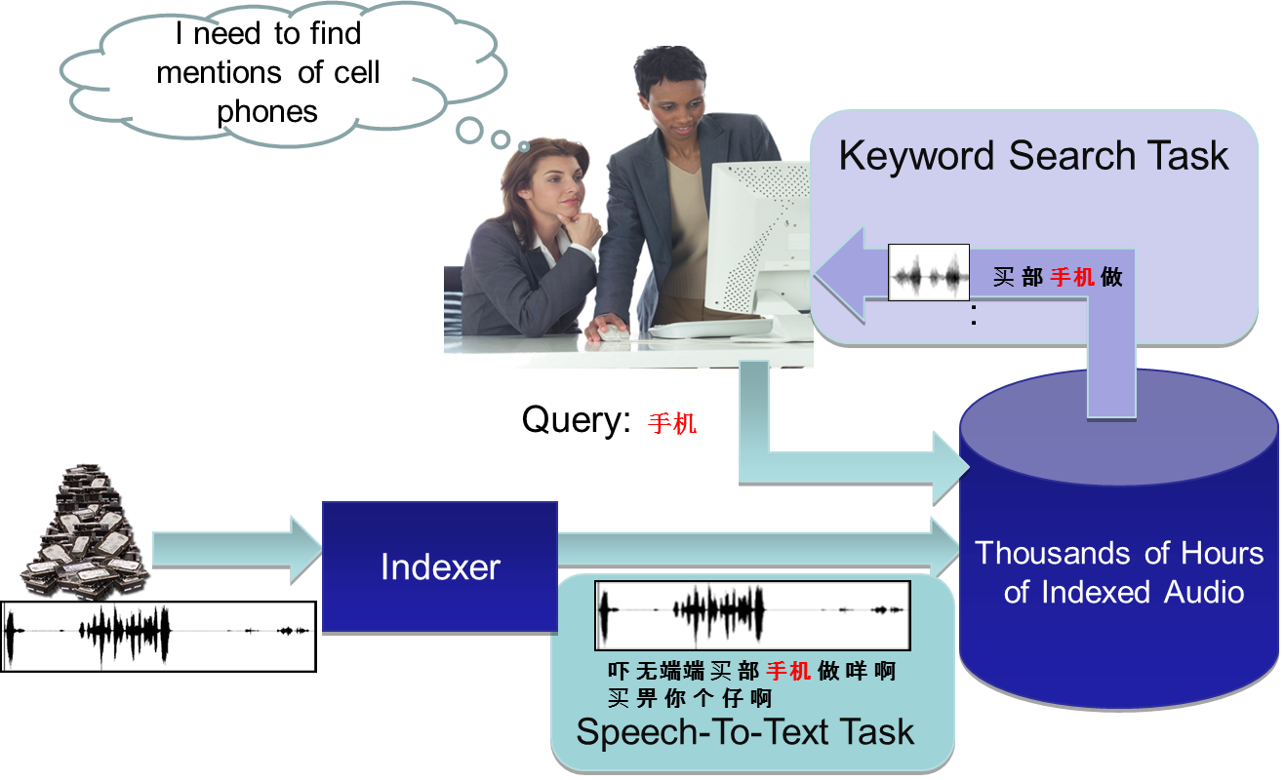
BABEL Speech Search Example
3
Notes:
Classification
Classification
3

Slide 4

The Babel Use Case
Limited training and adaptation data
User attributes:
Need to search large volumes of noisy speech data
Low tolerance for False Alarms
Looking for things with high information value (and possibly low frequency)
Looking for words and names that do not appear in training, and they are important
Have limited knowledge of the pronunciations of words in the language

Slide 5
Babel Designed to Address Two Gaps
Analysis Gap:
Developing human capital in new languages can take years
Must search through more speech files than can be listened to
Technology Gap:
Capability in only a handful of languages
7,105 living languages; 393 have 1M+ speakers (Ethnologue); only a few had been studied by anyone
Building systems for new languages took months to years prior to Babel and required a significant quantity of ground truth data for training
Systems developed for English did not work well on new languages and messy speech recordings
5
Notes:
Classification
Classification
5

Slide 6
Babel Program Overview
Babel began in March 2012 and completed in November 2017.
55-month program with four performance periods
Increasingly challenging performance goals each period
Open surprise language evaluation with participation from around the world
Transition of data and systems
6

Slide 7

























Babel Teams
Data Collection
T&E Team
Performer Teams

Slide 8

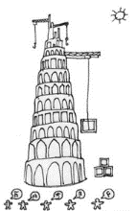
Babel’s Approach
Work with diverse languages from the outset
Acquire speech data in-country for a variety of less studied languages (26)
Study multiple languages each program period
Handle real recording conditions from the outset
Acquire data in a variety of conditions (e.g., in café, on the street) with different recording devices (e.g., cell phone, hands free microphone)
Increase the difficulty of the conditions each period
Rigorous evaluation
Use a “surprise” language for evaluation each period to foster a language independent approach
Achieve 6X improvement or better over phonetic search
Constrain resources and system development time each period
Reduce amount of “ground truth” speech for training (80→ 3 hours or less)
Reduce system development time (4 weeks → 1 week)
8

Slide 9
Data Design
Languages are chosen:
From a variety of language families (e.g., Afro-Asiatic, Niger-Congo, Sino-Tibetan, Austronesian, Dravidian, Altaic)
With a variety of different features (i.e., various scripts, different phonotactic, morphological, syntactic characteristics, tonal)
Audio data are collected in-country:
Dialectal variation
Wide variety of environments: home office (landline or mobile), public place, street, in vehicle, car kit, and others
Network and handset diversity
Non-telephone channels after first period
Variety of speakers (gender, age, dialect)
9
Notes:
Classification
Classification
9

Slide 10
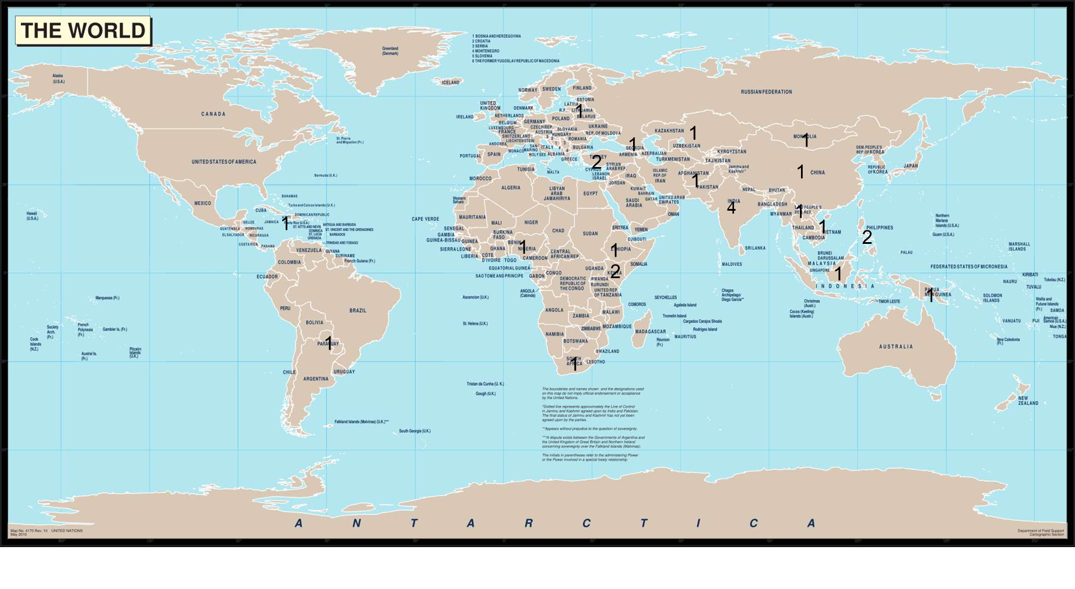
Languages

Slide 11
Babel Language Challenges by Period
11

Slide 12

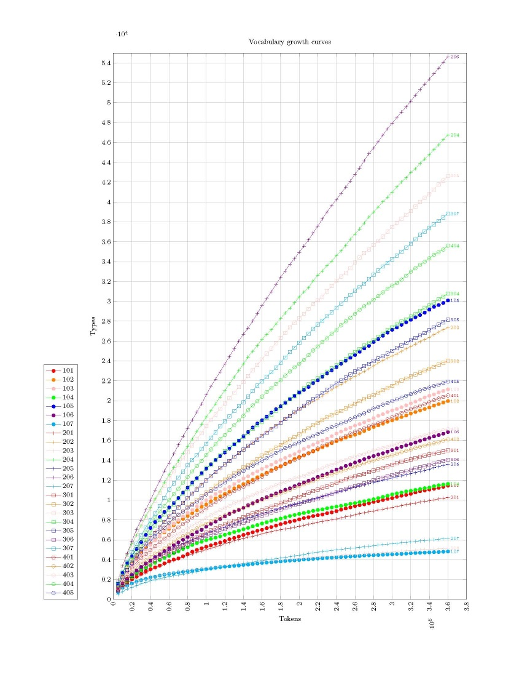
The Challenge of Out-of-Vocabulary (OOV) Words and Keywords (KWs)
Languages with a large number of word variants will not be covered by the very limited amounts of training data.
Doing well with limited training data requires accurate search for word forms not observed in training.
Vocabulary Growth Rate

Slide 13
Program Metric Summary
Word Error Rate (WER) is calculated using alignment of system (sys) and reference (ref) tokens transcripts and counting up errors: insertions (I), deletions (D), and substitutions(S). The lower the score the better, with the lowest possible value being 0. Error can exceed 100%.
WER = (I+D+S)/ # ref words
Actual Term Weighted Value (ATWV) is a keyword search metric that considers miss and false alarm errors at the term level, so that rare terms are as important as frequent terms. The higher the score the better, and the range is between 0 and 1.

Slide 14
Cheating System
Basic Kaldi SGMM/MMI System
13 PLP + ∆ + ∆∆ + pitch features
No DNN or multi-lingual features
Eval: used oracle segmentation
Used language build pack pronunciation dict
Full set of transcriptions used
Training + dev + eval used for lexicon and LM
Basic KWS (FST based)

Slide 15
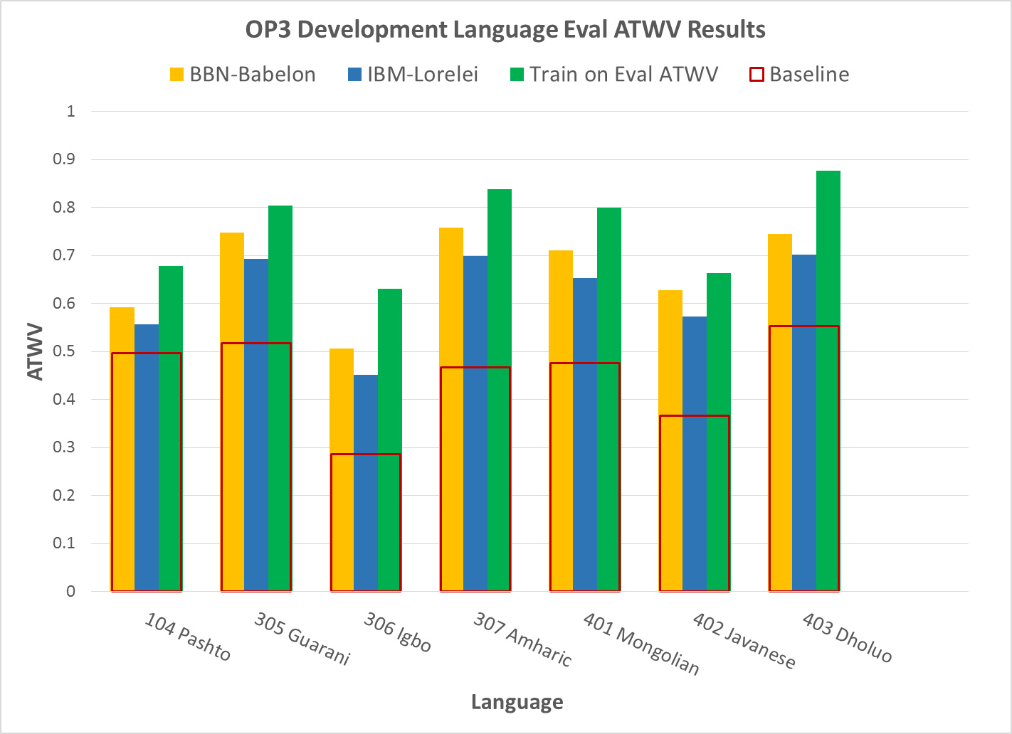
ATWV Evaluation Results on Development Languages

Slide 16
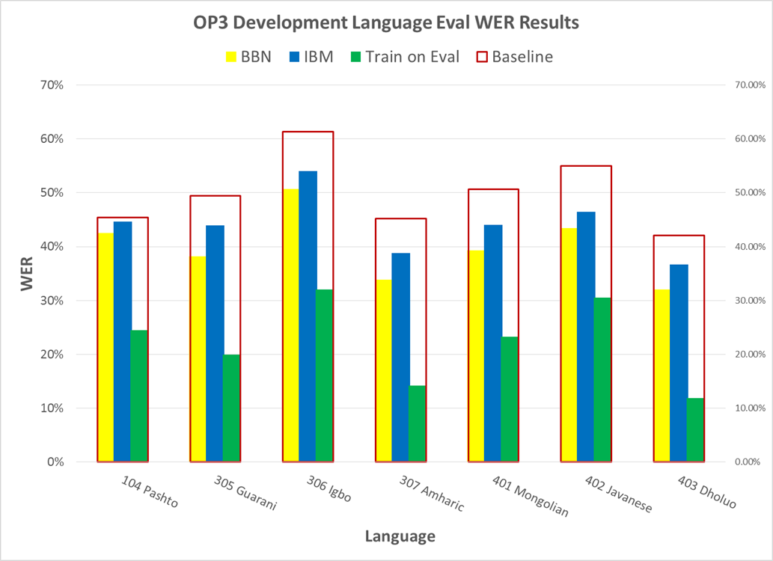
WER Evaluation Results on Development Languages

Slide 17
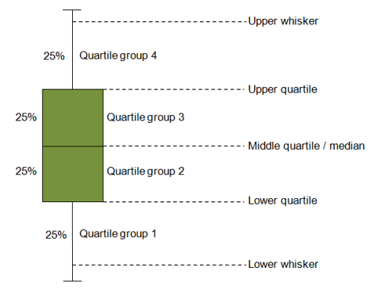
Distributions Using Whisker Plots

Slide 18
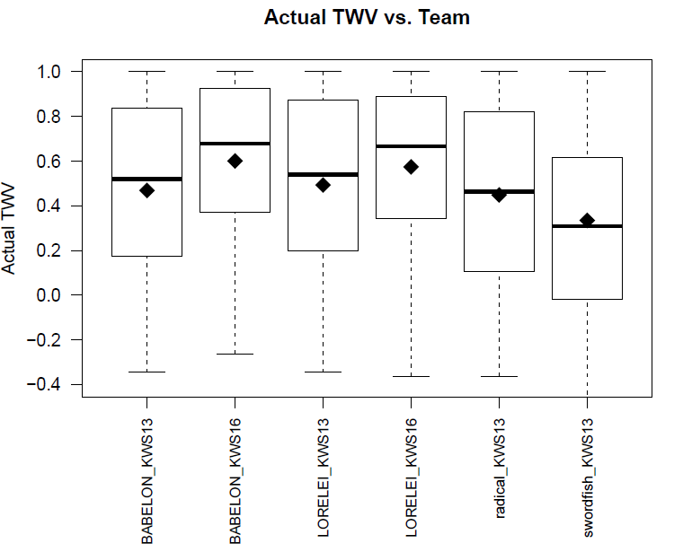
OP3 Development Language Analysis
104 BP (80 hrs) versus OP3 (40 hrs) KW Score Distribution

Slide 19
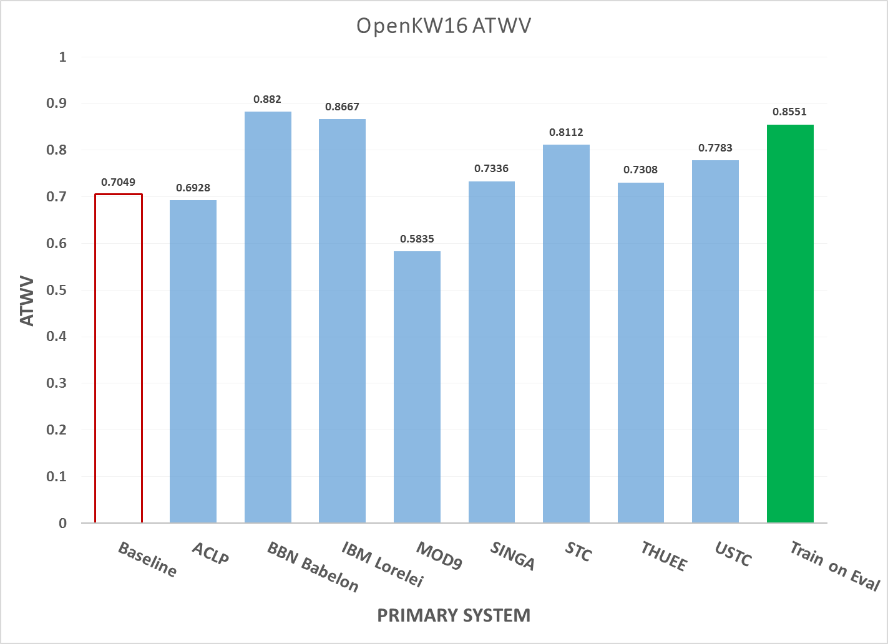
OpenKWS16 ATWV Results on Primary Systems

Slide 20
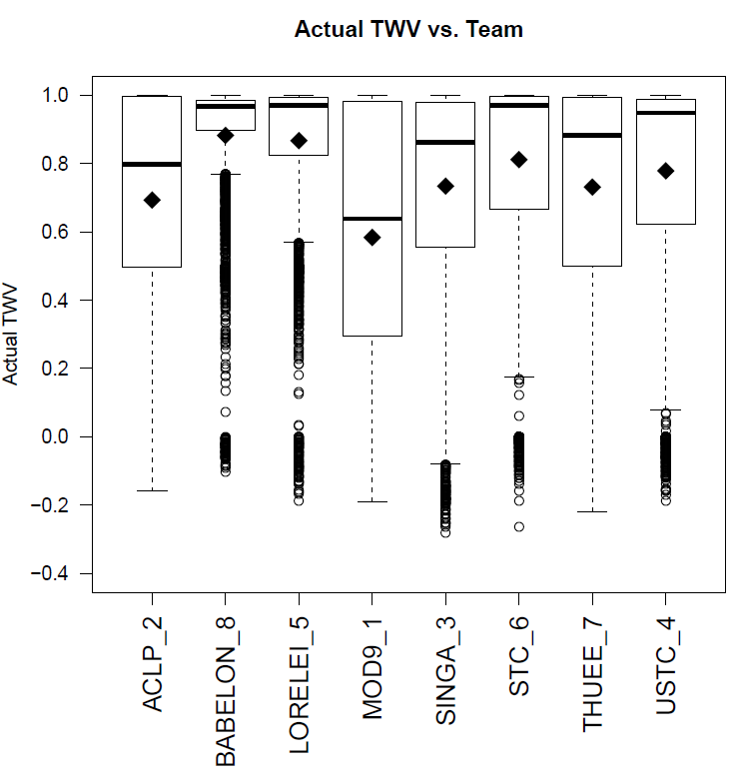
OpenKWS16 FullLP Surprise Language Analysis

Slide 21
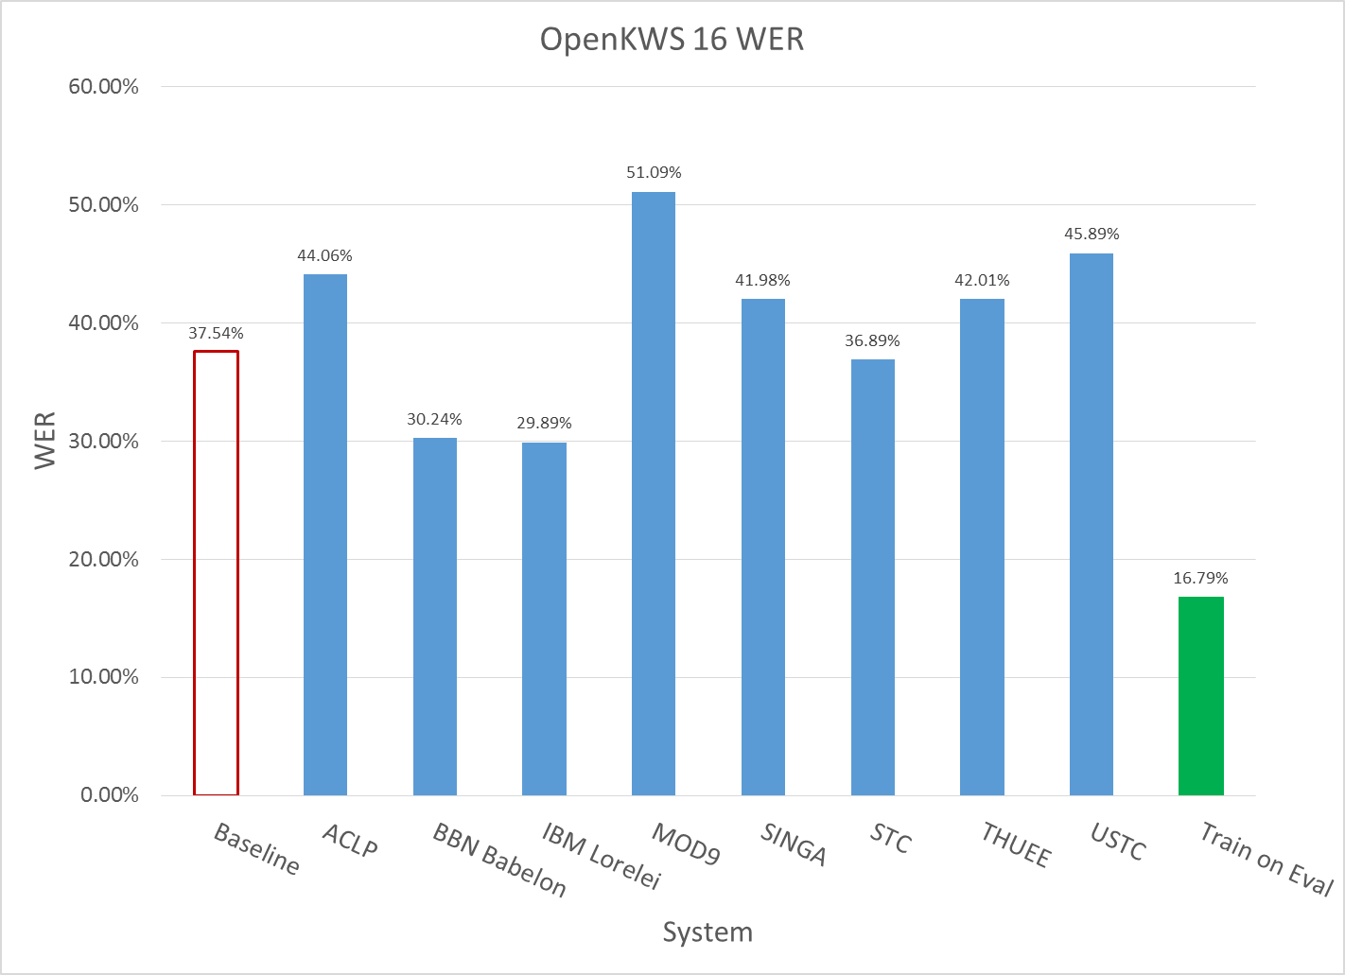
OpenKWS16 WER Results on Primary Systems

Slide 22
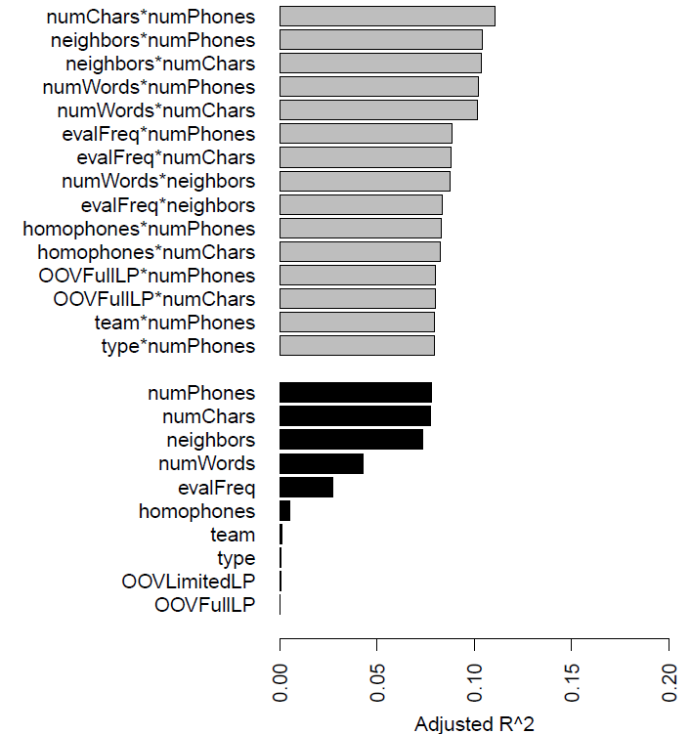
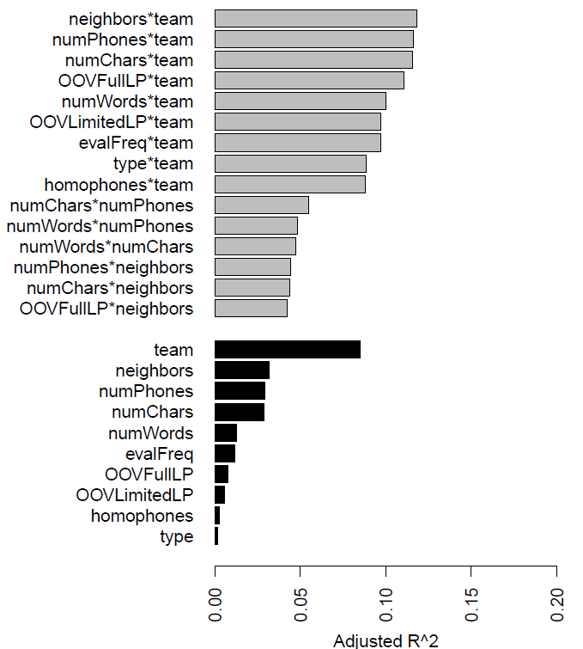
OpenKWS16 Surprise Language Analysis
Babel Teams Top Factors and Interactions
All Teams Top Factors and Interactions

Slide 23

Best Systems
Preprocessing and Features: re-segmentation and silence modeling, robust multilingual deep neural network speech features with pitch
Out-of Vocabulary Handling: decoding and searching on subword units and combining across different token types; effective harvesting and use of web text
Keyword search: score normalization, system and token combination, and methods for preserving potential hits as search alternatives
Modeling: Deep learning advances, exploiting automatic labeling of untranscribed audio and/or transformations of transcribed audio to add bolster variability, multilingual modeling

Slide 24
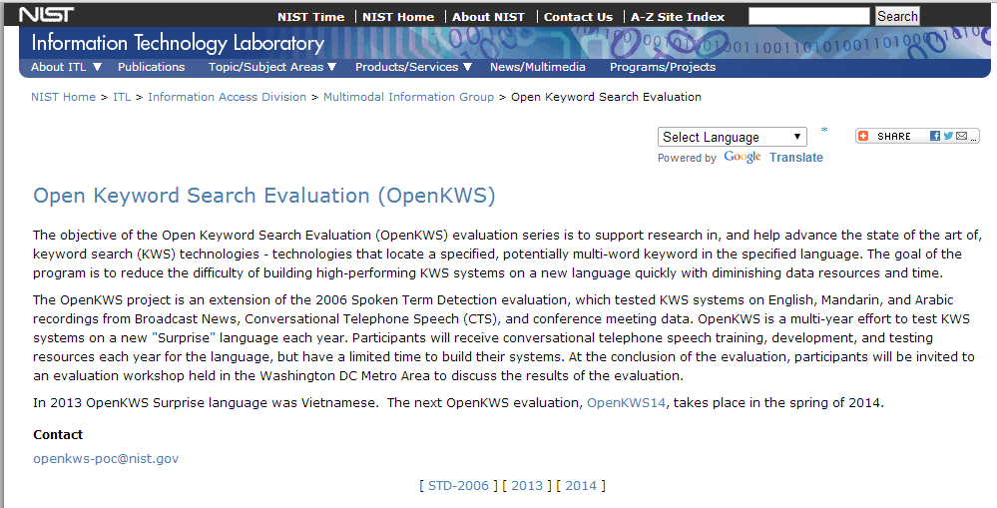
Babel-Related Publications
To access Babel program-related publications, please enter the following into a Google Scholar search query: "W911NF-12-C-0012 OR W911NF-12-C-0013 OR W911NF-12-C-0014 OR W911NF-12-C-0015“
For information on NIST’s OpenKWS evaluations see: http://www.nist.gov/itl/iad/mig/openkws.cfm
Data available through LDC and through GCLR.

Slide 25
Backups

Slide 26
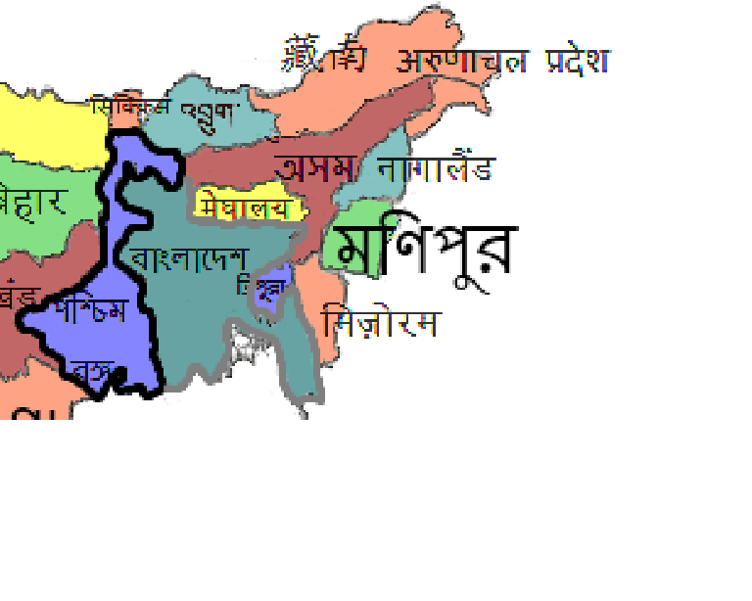
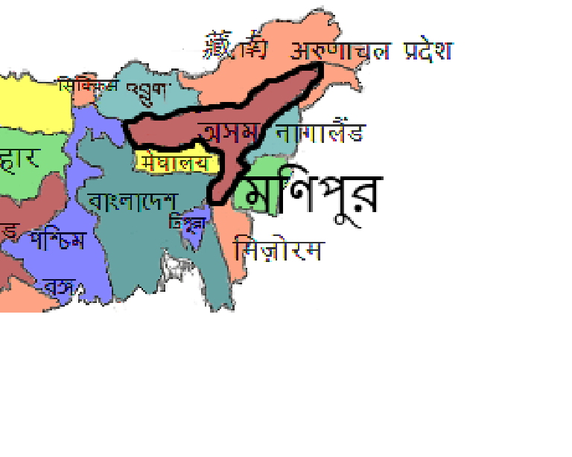
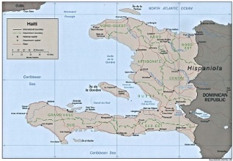
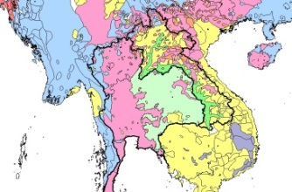
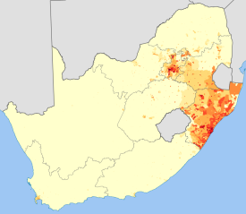
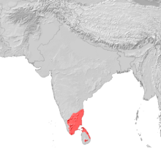
Period 1 Languages

Slide 27
Period 2 Languages

Slide 28
Period 3 Languages

Slide 29
Period 4 Languages

